Slide 1
CAMPSYS
User Manual
MARKETING MODULE
V1.0

Slide 2
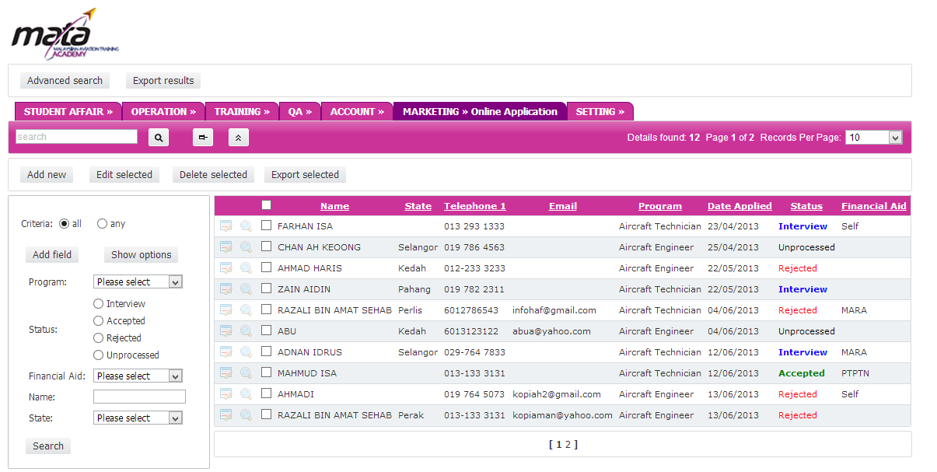
OVERVIEW-GENERAL INTERFACE
QUICK SEARCH – Find student name quickly
DELETE -Permenantly delete selected record
MAIN MENU- MARKETING
RECORD PER PAGE– Limit the record list per page
CHECKBOX – Can be selected for action.
ADD FIELD- Additional Search filter
VIEW RECORD-View selected record details
PAGINATION- Navigate to other records
SEARCH PANEL- Search particular records
EDIT RECORD-Edit selected record

Slide 3
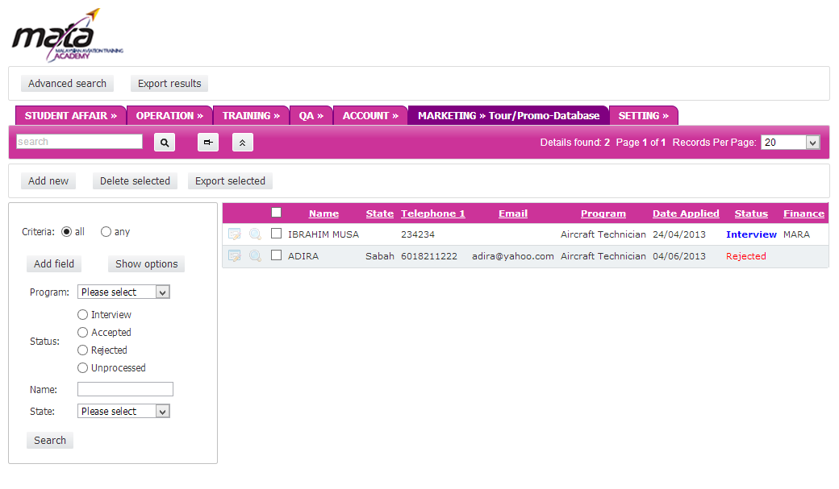
MENU
TOUR/PROMO

